Slide 1
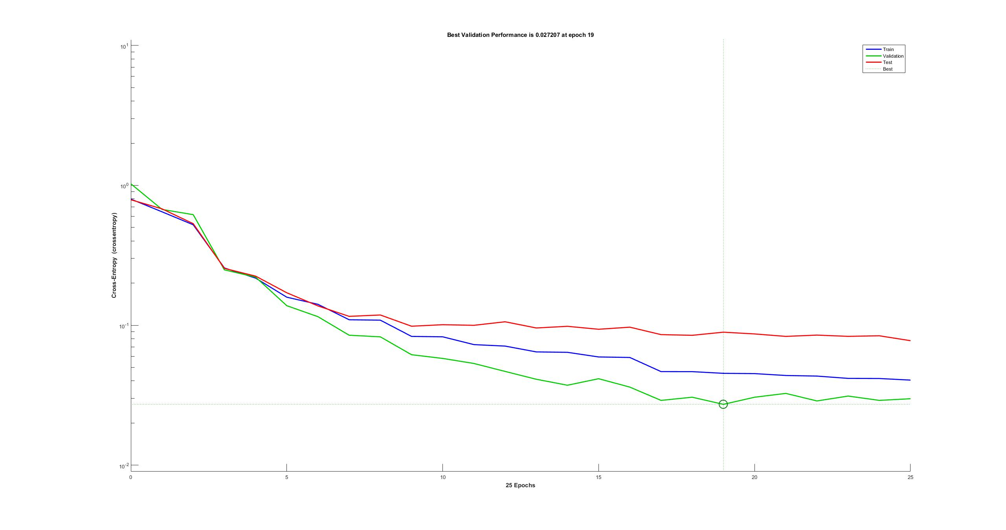
Cancer Data
Best Validation Performance is 0.0272 at epoch 19
10¹
10⁰
10⁻¹
10⁻²
Cross Entropy (crossentropy)
Test
Train
Validation
Best
0 5 10 15 20 25
25 Epochs

Slide 2
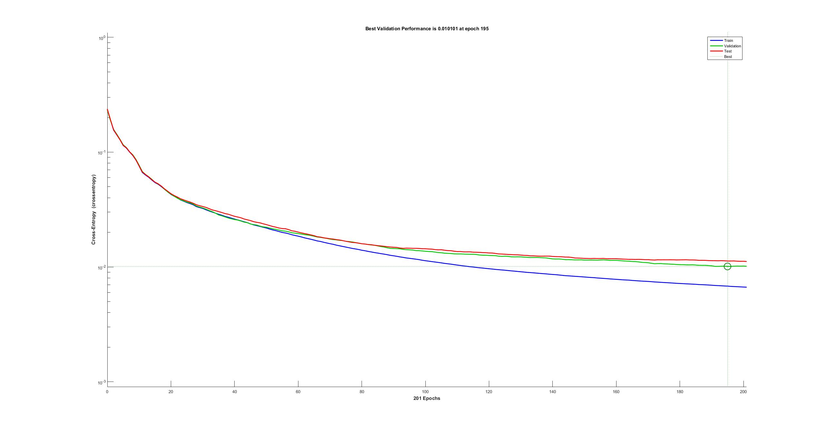
Character Data
Best Validation Performance is 0.0101 at epoch 195
10⁰
10⁻¹
10⁻²
10⁻³
Cross Entropy (crossentropy)
Test
Validation
Best
Train
0 40 80 120 160 200
201 Epochs

Slide 3
Cancer Data
Best Validation Performance is 0.0272 at epoch 19
Character Data
Best Validation Performance is 0.0101 at epoch 195
10¹
10⁰
10⁻¹
10⁻²
10⁰
10⁻¹
10⁻²
10⁻³
Cross Entropy (crossentropy)
Test
Test
Validation
Best
Train
Train
Validation
Best
0 5 10 15 20 25
0 40 80 120 160 200
25 Epochs
201 Epochs

Slide 4
Character Data
Best Validation Performance is 0.0101 at epoch 195
10⁰
10⁻¹
10⁻²
10⁻³
Cross Entropy (crossentropy)
Test
Validation
Best
Train
0 40 80 120 160 200
201 Epochs

